Slide 1
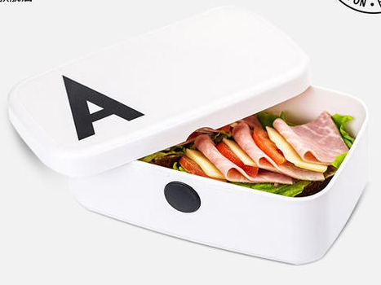

PADA EAT

Slide 2
*transactionID
*userID
name
name
name
name
userID
shopID
name
name
使用者資料表
User
交易資料表
transaction
transaction Time
ext
PWD
name
*foodID
name
transactionID
便當明細資料表
food
CommodityID
*shopID
name
shopName
amount
name
name
userID
name
*Commodity ID
店家資料表
Shop
name
商品資料表
Commodity
shopID
shopPhone
name
shopTime
name
name
price
name
shopAddress
commodityName
name
name

Slide 3
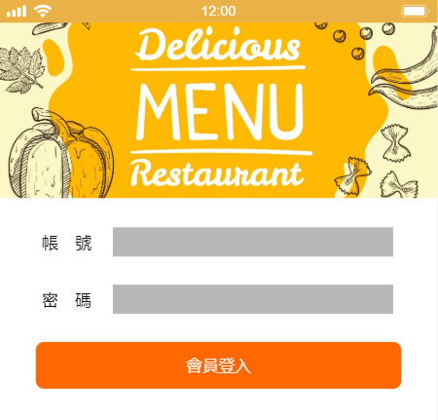
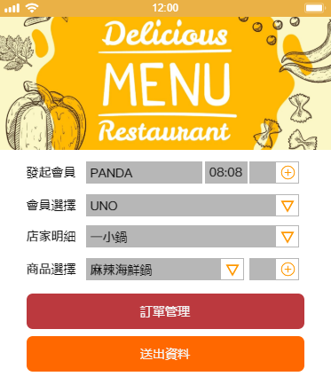
STEP 1
STEP 2

Slide 4
列出每筆訂單訂購會員商品數量及總額
列出指定店家菜單
DELIMITER $$
CREATE PROCEDURE usertotal2(number INT)
BEGIN
SELECT DISTINCT
user.userID,commodityName,price,amount,(price*amount)as total
FROM
commodity LEFT JOIN food ON
commodity.CommodityID = food.CommodityID
LEFT JOIN user ON
user.userID = food.userID
WHERE
food.transactionID = number;
end $$
DELIMITER $$
CREATE PROCEDURE showmenu(ID INT)
BEGIN
SELECT DISTINCT
commodityName,price
FROM
commodity
WHERE
shopID=ID;
END $$

